Slide 1
5-1 Working with asset packs
5CM503 Virtual Environment Development
Dr Patrick Merritt

Slide 2
Contents

Slide 3
Asset packs
What, why and how….

Slide 4
What is an asset pack?
An asset pack is a collection of assets usually designed to build a specific environment.
Where we use a game engine to replace the systems programmer, we can use an asset pack to replace some of the creative work in game environment.

Slide 5
So where can I get asset packs?
Honestly, everywhere!
You have some experience from last year when I made you go and find art assets for your games.
When things get 3D though, things get a little trickier…

Slide 6
You get what you pay for…
Yes, you can get free asset packs, often they are samplers for larger packs or a single pack from a bigger collection.
But generally, if someone is giving something away for free it usually means its going to be of lower quality and more difficult to work with.

Slide 7
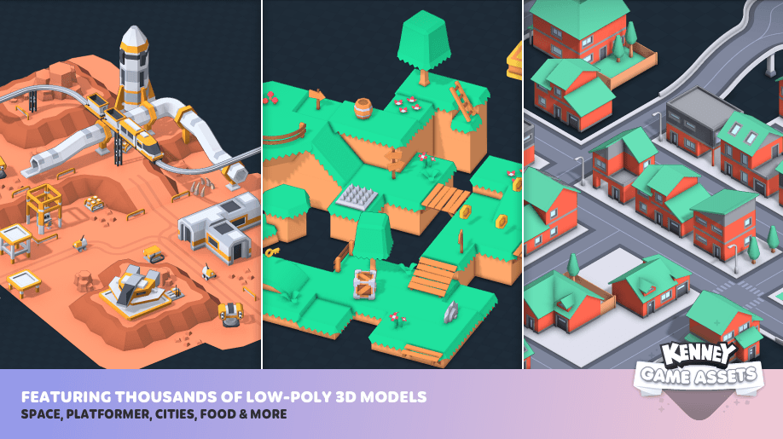
Kenney Asset Pack
I have genuinely been using this for years, (since my degree in fact)
An excellent all-round pack, nothing amazing, but all the pieces you need to make a lot of different 2D and 3D games.
Comes with UI elements and sound effects which is a big bonus.
https://kenney.itch.io/kenney-game-assets

Slide 8
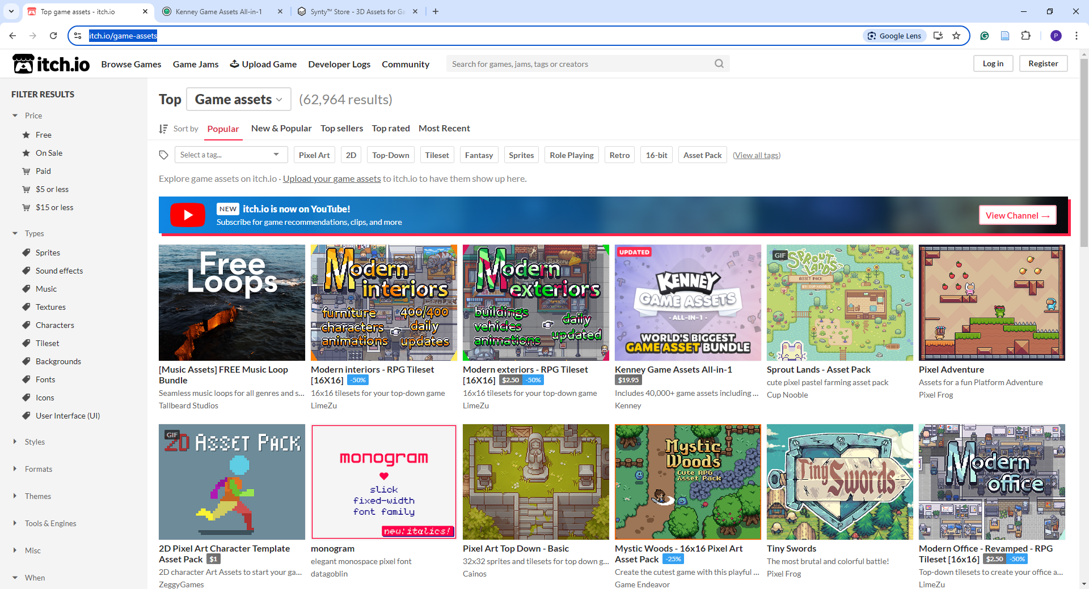
Itch.io
Marketplace for indie games and assets.
Find what you need, for free or relatively cheap.
Does have some garbage though…
https://itch.io/game-assets

Slide 9
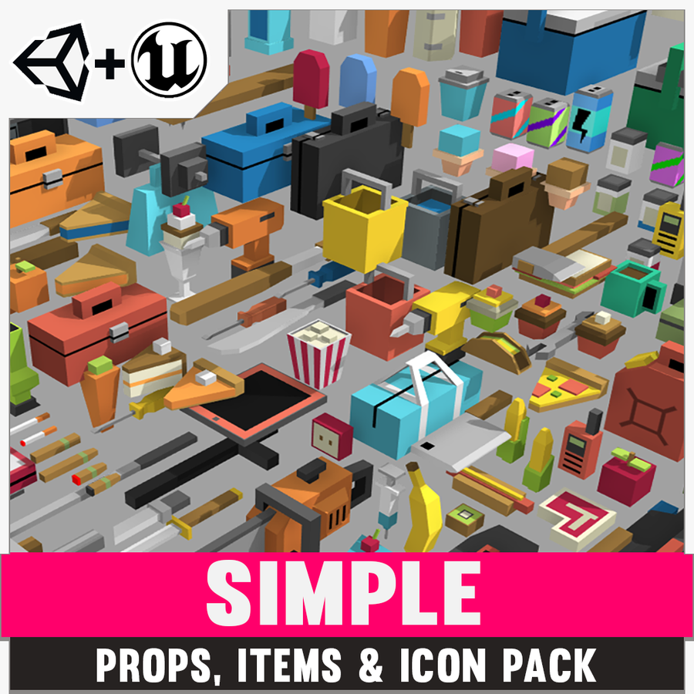
Synty
Great assets,
Very specific,
Very expensive!
Often on sale, lots of assets end up in bundles with heavy discounts.
https://syntystore.com/en-gb

Slide 10
The Unreal Marketplace
Get assets and extensions downloaded right into the project.
Often expensive
Locked to the engine.
Free content monthly ☺.
Can also add in engine features!
Helpful to fix a complex technical challenge.
Employing an additional systems programmer.
https://marketplace-website-node-launcher-prod.ol.epicgames.com/ue/marketplace/en-US/store

Slide 11
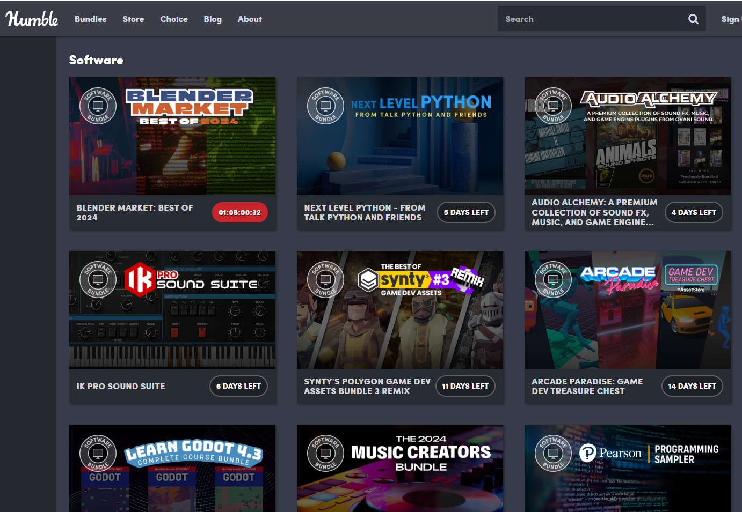
Humble Bundle
Cheap and plentiful :D
No control over what is available!
WIWIG
Also has tutorial series for most game engines and tools such as blender.
Some money goes to charity!
https://www.humblebundle.com/software

Slide 12
So how do I use these?
Drop them in and start throwing them around.
Well, not quite…
Sometimes you need to do a bit of prep work.

Slide 13
Just a word about file sizes…
Importing lots of asset packs quickly ramps up the file sizes of your projects.
Particularly high quality meshes and textures.
Think before importing.
You can remove parts of packages you are not using.
Things that are not needed, add unnecessary bloat.
Not a terrible problem unless you move the project or work on it from a cloud service.
Particularly, demo scenes.

Slide 14
Organising
Depends what you are importing…
One or two items, organise it with everything else in your project.
Whole package, probably import the whole structure.

Slide 15
Individual imports or external assets
Generally as a rule, if you bought something from the asset store, it should just work out of the box.
Importing generic assets can be a little more tricky.
Scale is usually an issue.
Do one and apply the settings to all.

Slide 16
Importing a mesh
You will at least have a mesh, this contains the geometry of the object, the shape if you will.
You may have one or more of the following or they may be included with the mesh file.
Materials
The material to apply to the asset to apply colour and mapping details.
Textures
The image containing, colour and mapping data.
Animations
Animations to make your mesh move.

Slide 17
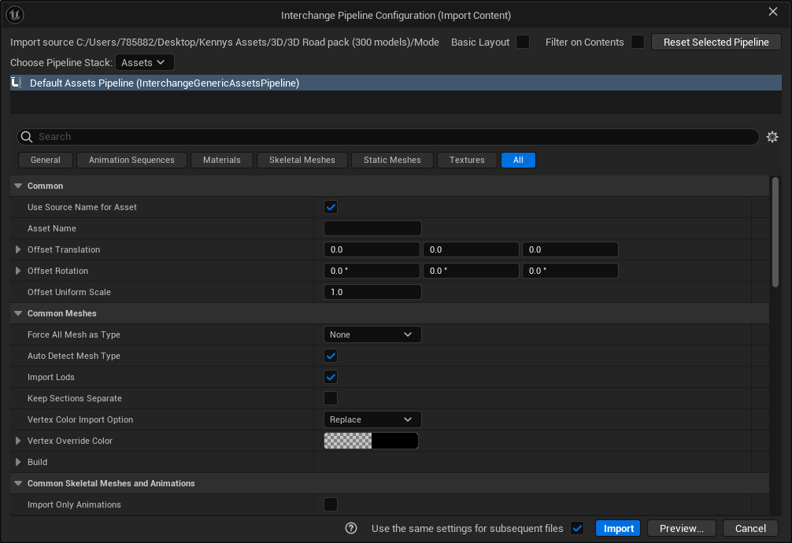

Slide 18
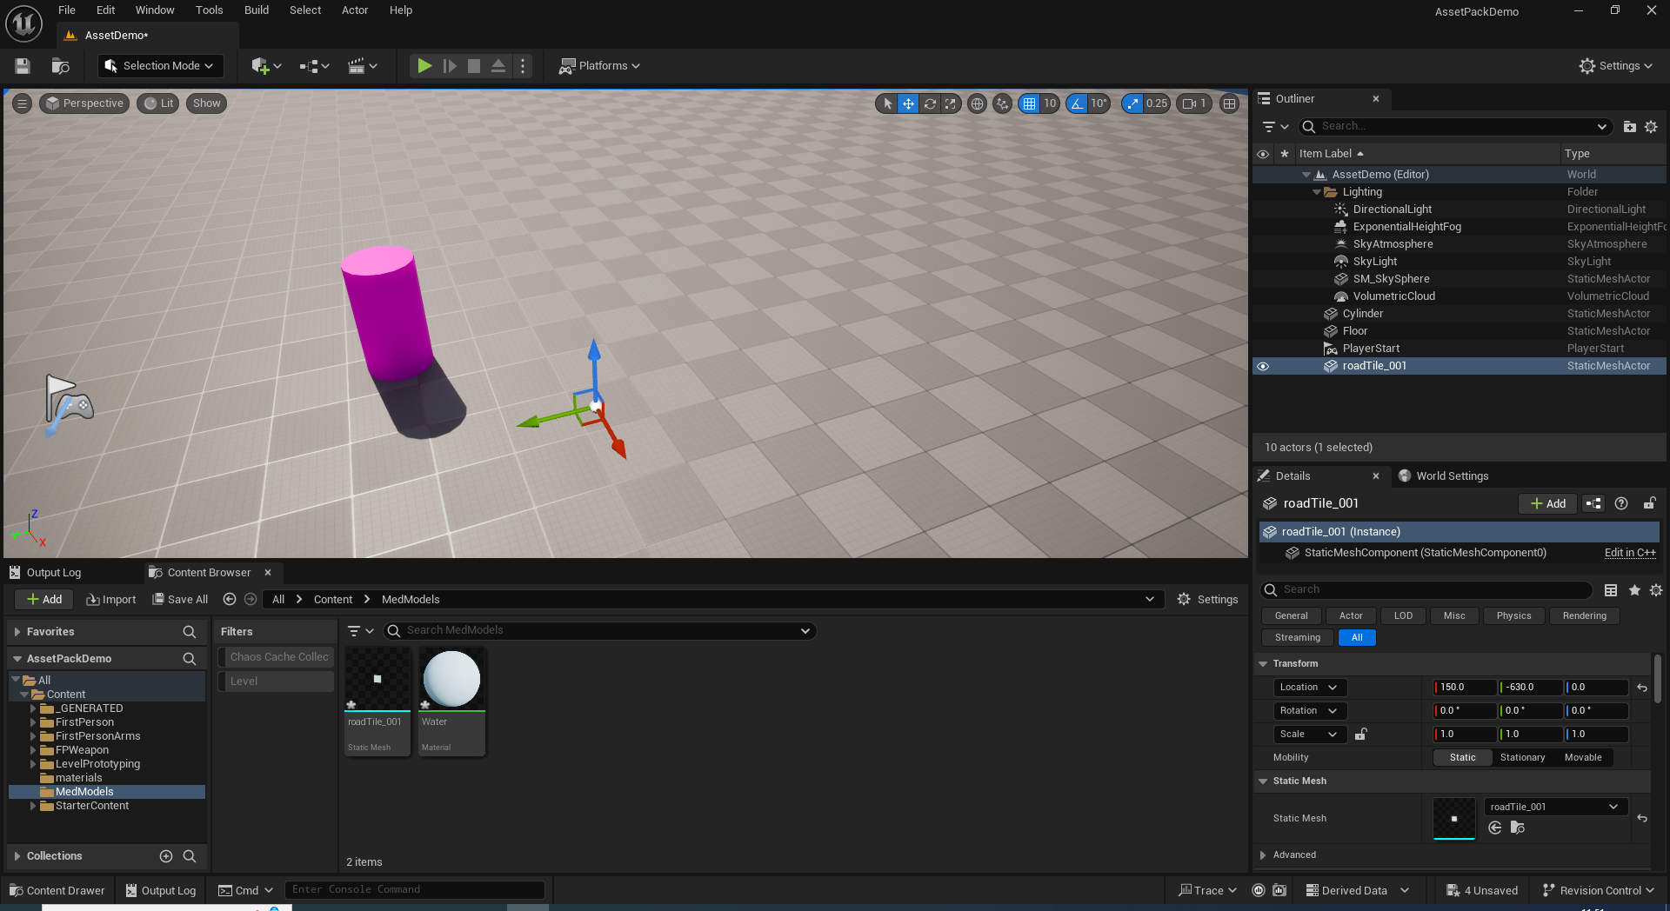
After importing, check the model by dragging it into the level

Slide 19
In this case, the model appears to be invisible….

Slide 20
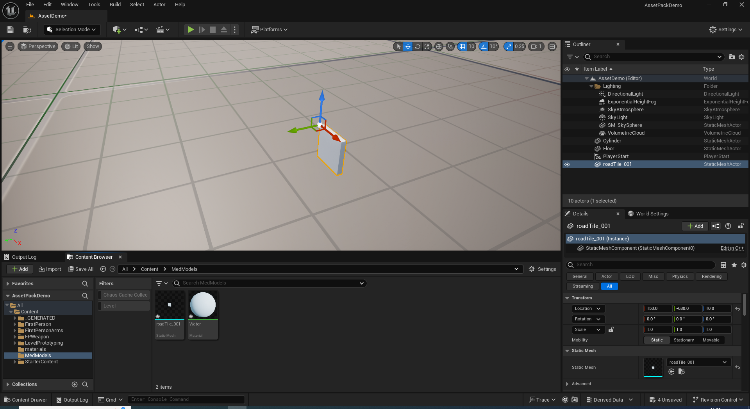
But in reality, it is just really small…

Slide 21
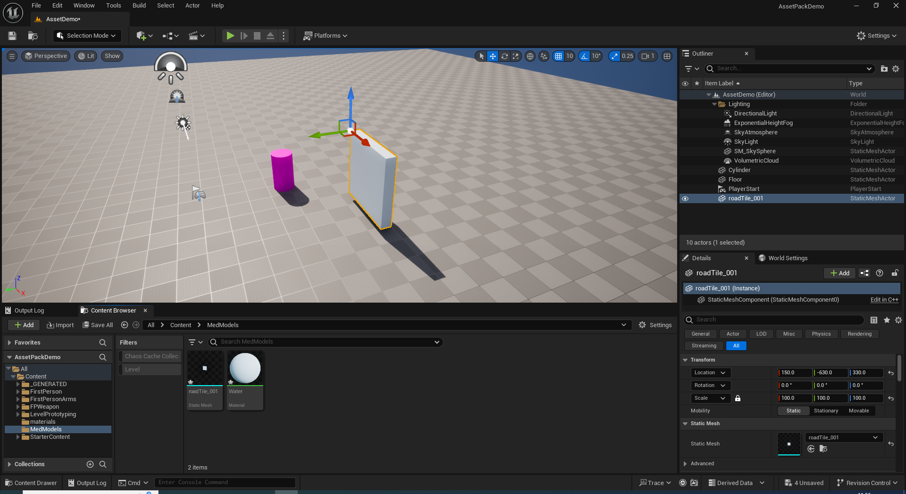
Uniformly adjust the scale to the correct scale.
HINT:- its normally a power of 10, the difference between mm, cm and meters.
If it was in inches, have fun with that :D

Slide 22
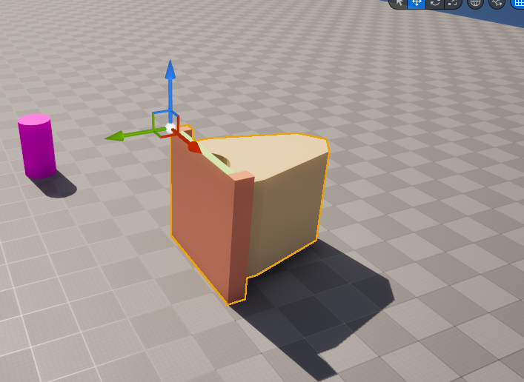
The up and forward axis…
You need to align the model to the correct axis.
This is so when you use the direction vectors later in the program they are aligned correctly.
Unfortunately, this is not standard...
Unreal uses X as FORWARD and Z as UP

Slide 23
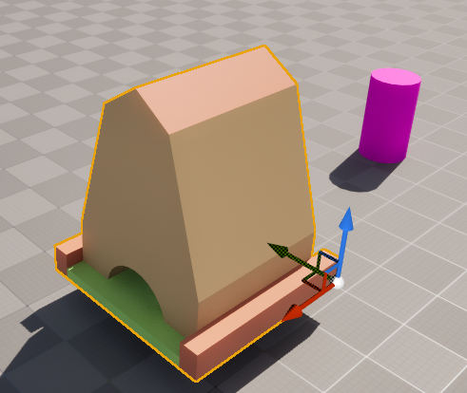
The up and forward axis…
In simple terms, rotate the model to align the model so that…
The model aligns vertically to the blue Z arrow.
The front of the model aligns to the red X arrow.

Slide 24
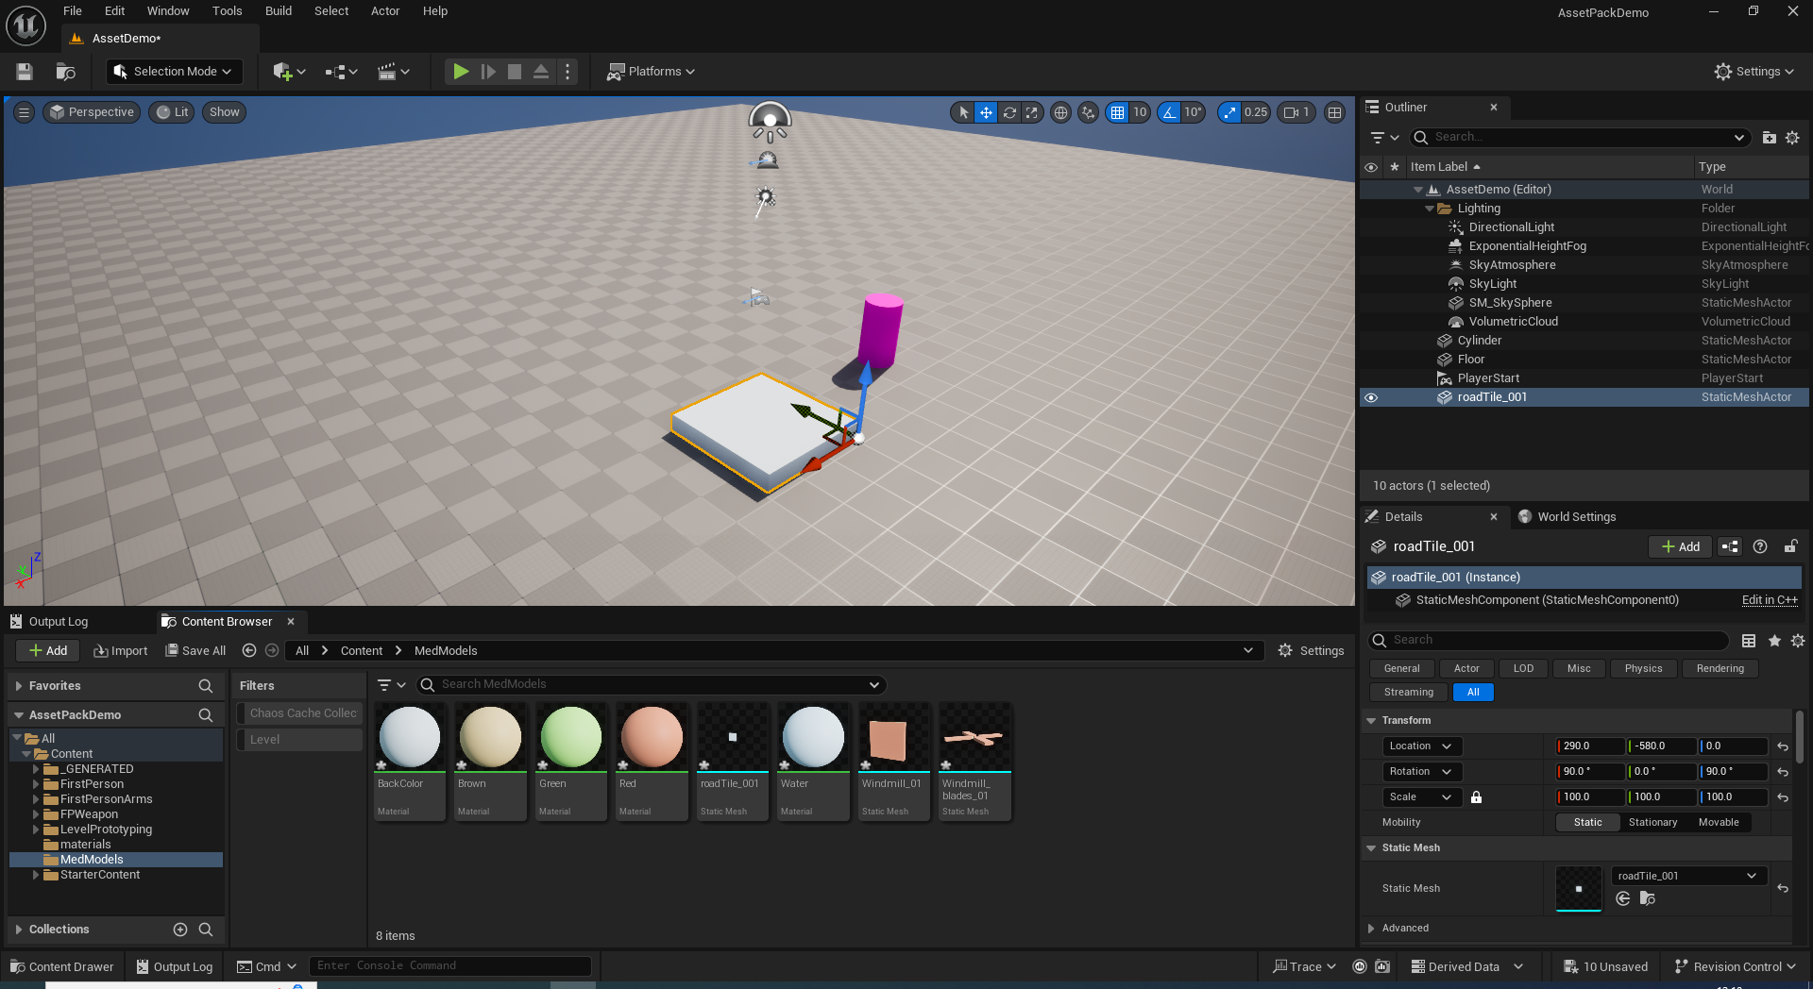
Once the settings are correct…

Slide 25
Make a note of them…

Slide 26
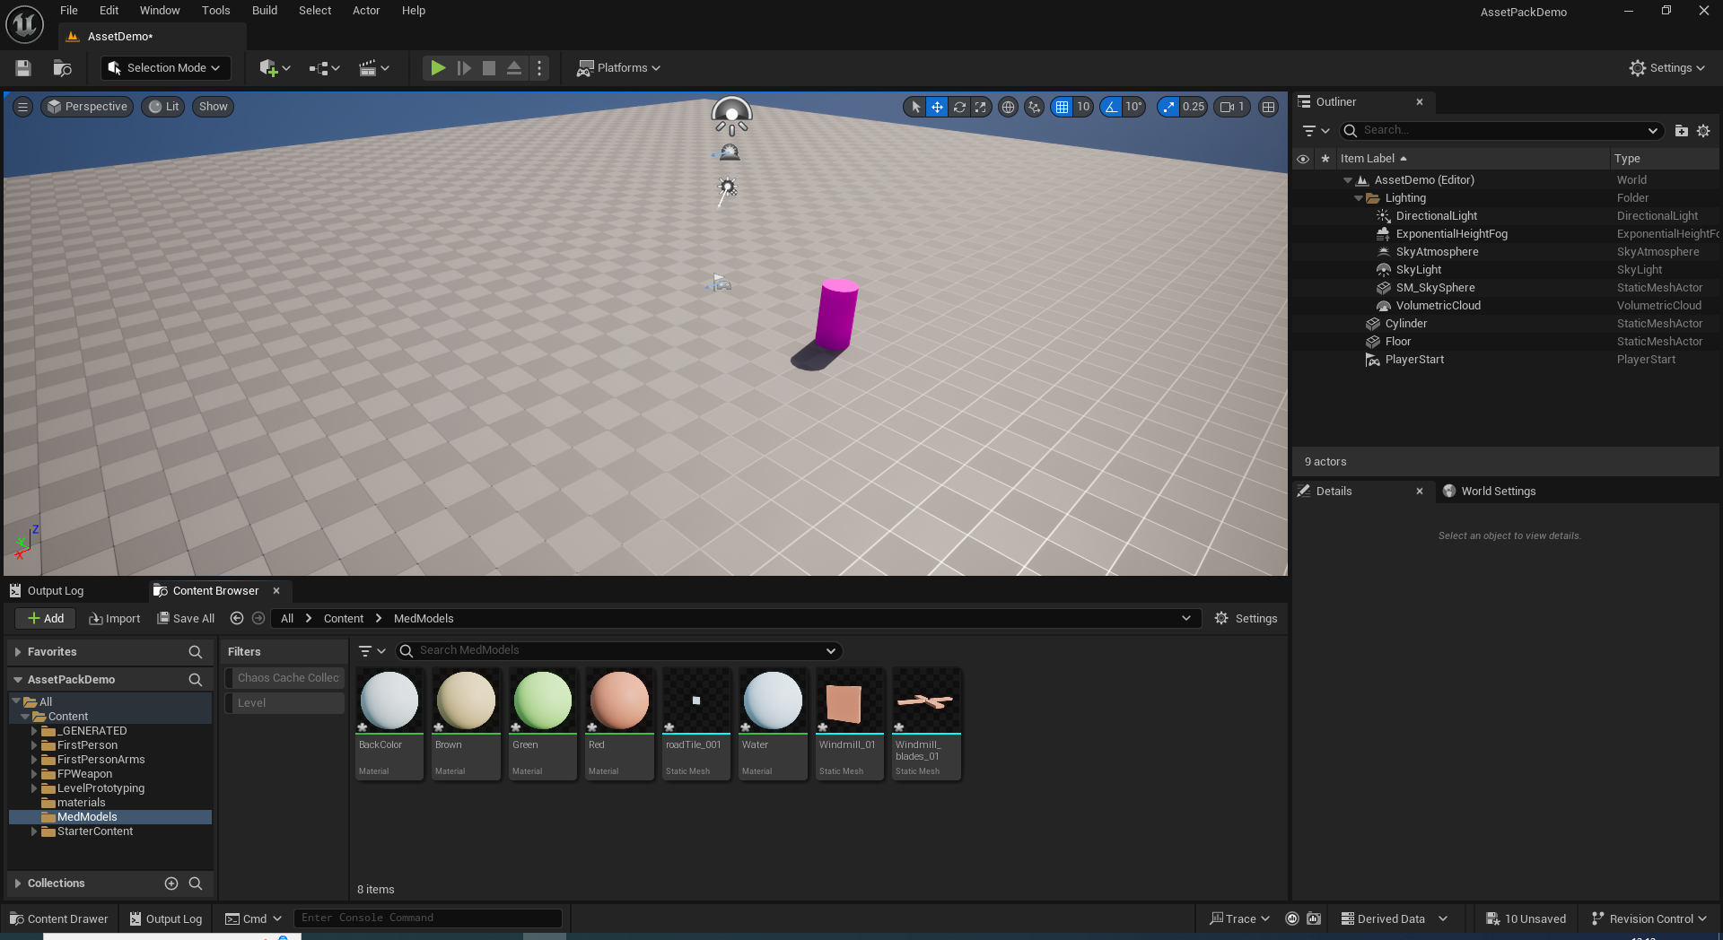
Delete the model…

Slide 27
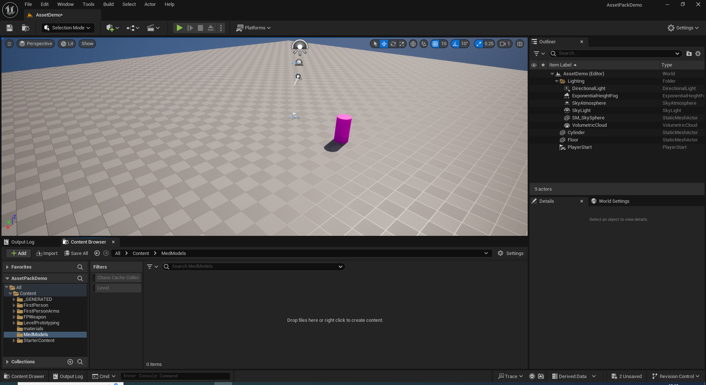
And delete the asset…

Slide 28

Apply those settings at import

Slide 29
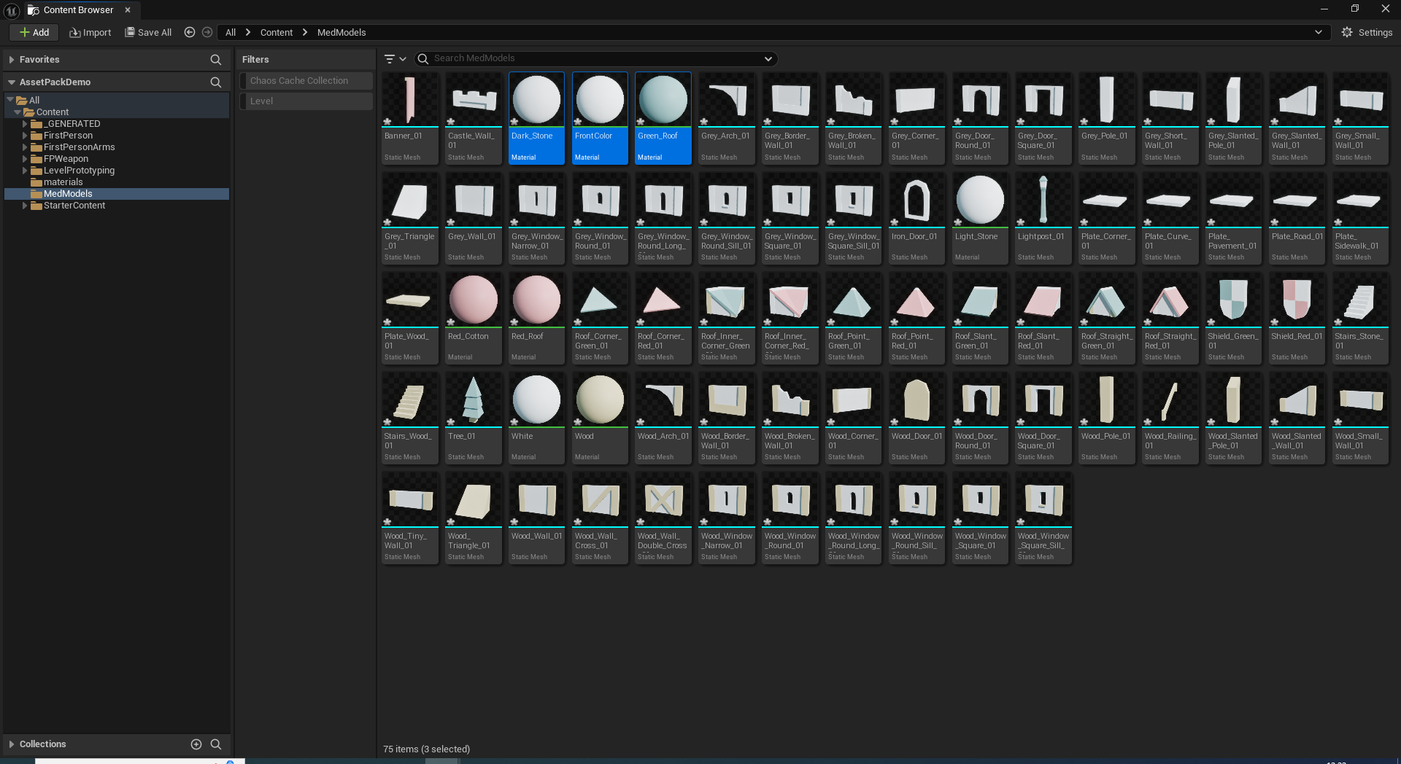
Tada!
Best to organise this folder now, keep it tidy :D

Slide 30
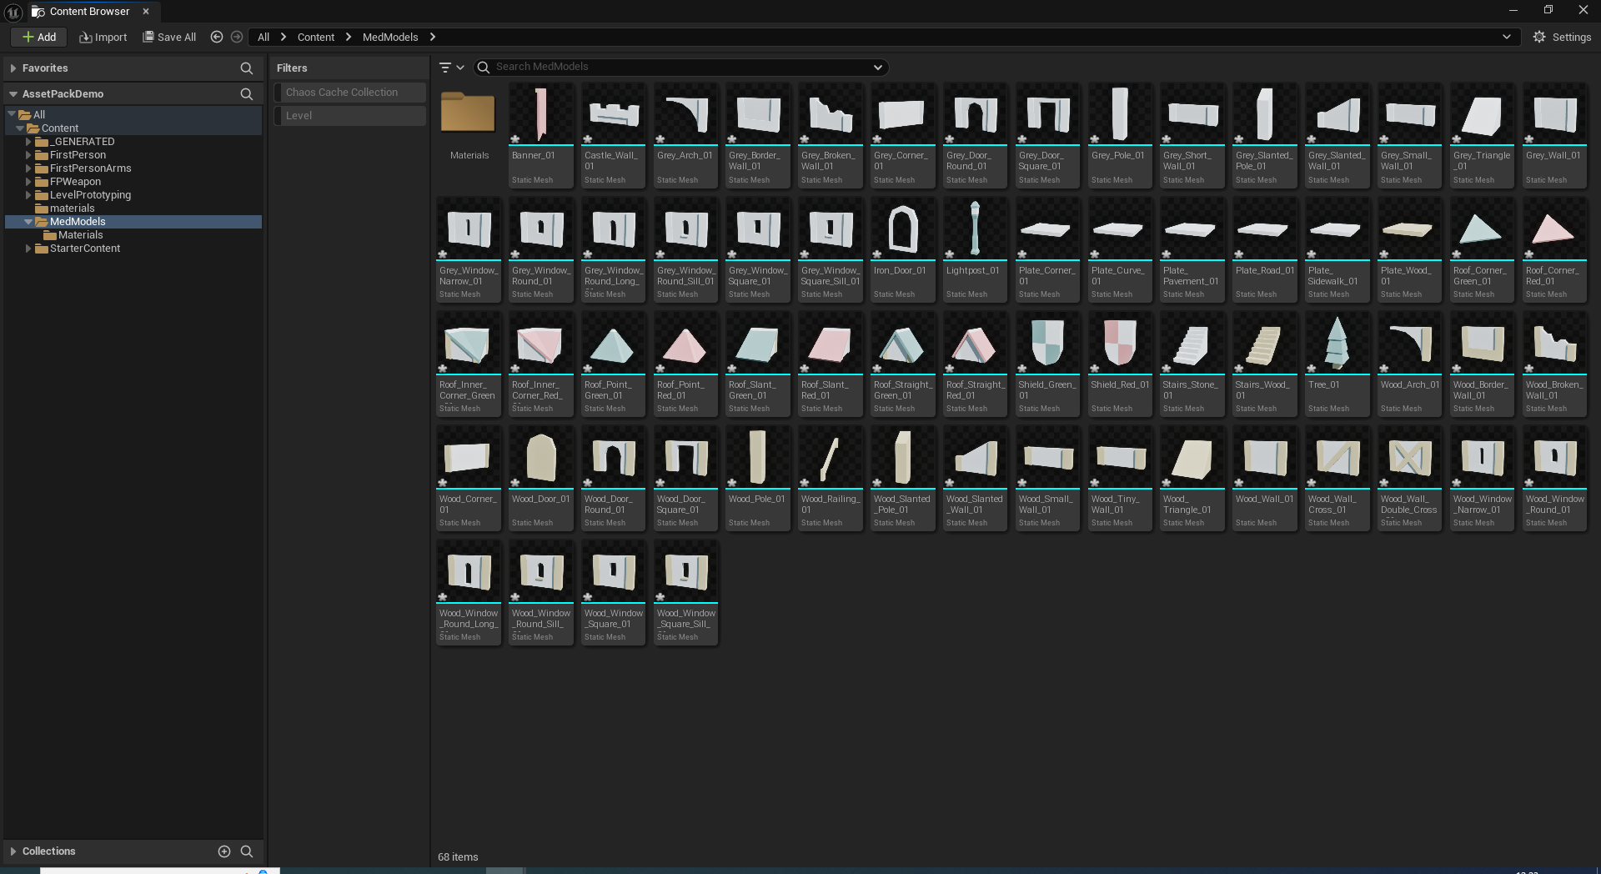
Better, think of this as a pallet of our assets to build our level with. We wont be dragging out materials but we will be dragging out assets.

Slide 31
This is what we call a modular asset pack, rather than having several fully complete models, we have pieces that, when placed together can be used to create multiple buildings quickly and efficiently.

Slide 32
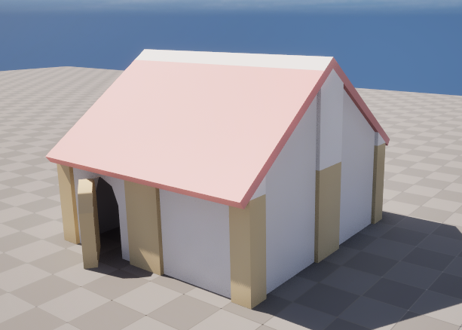

Slide 33
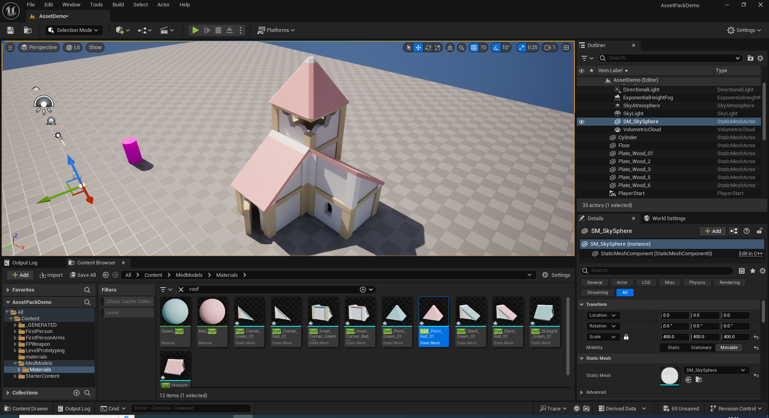
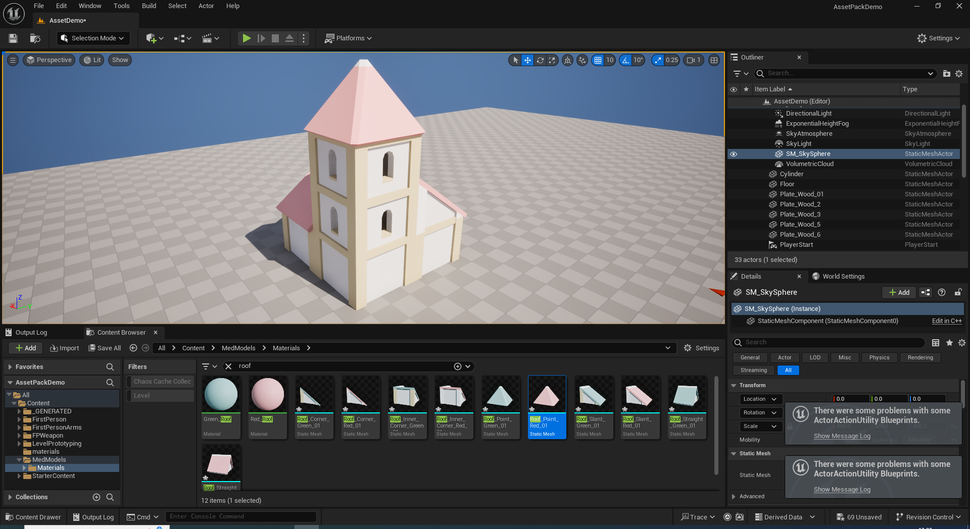

Slide 34
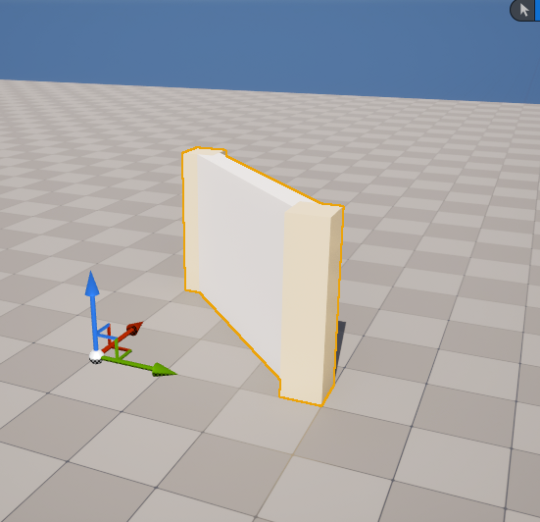
Pivot points
All models rotate around the pivot point, visually represented by the white ball in the centre of the handle.
Not so much of a problem for meshes that never move, just awkward to work with…

Slide 35
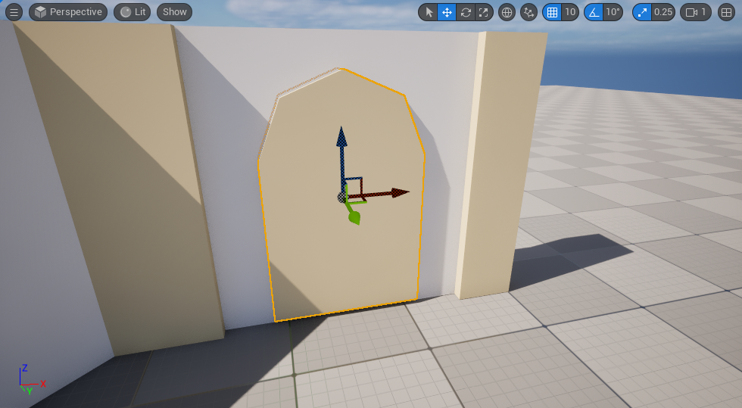
However, consider this door…

Slide 36
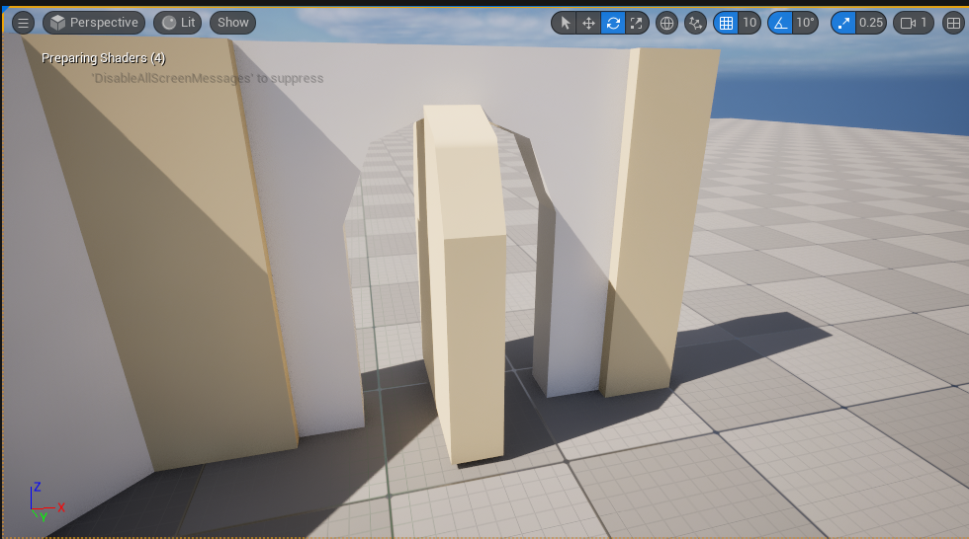
Uh oh…

Slide 37
Pivots can be edited…
WARNING!!!
A PROGRAMMER SHOULD NOT EVER BE EDITING A MESH WITHOUT PERMISSION FROM THE ARTIST!

Slide 38
What’s wrong with this door?

Slide 39
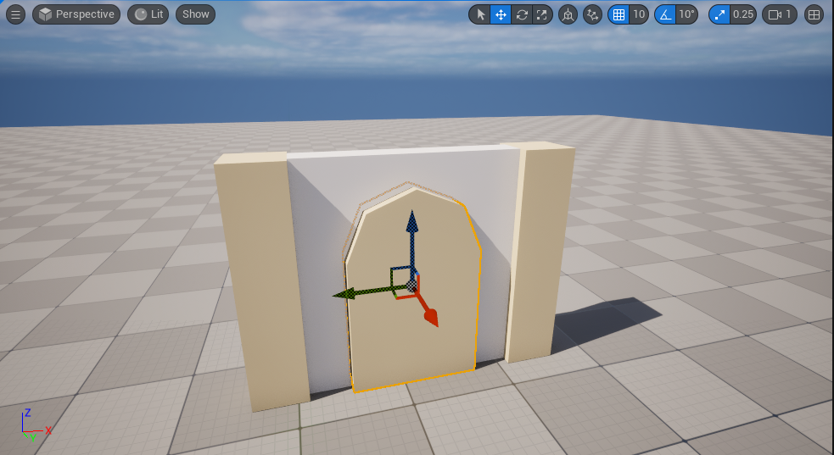
Better ☺
World vs local handles, do the initial setup in world space and evaluate they are correct using local handles

Slide 40
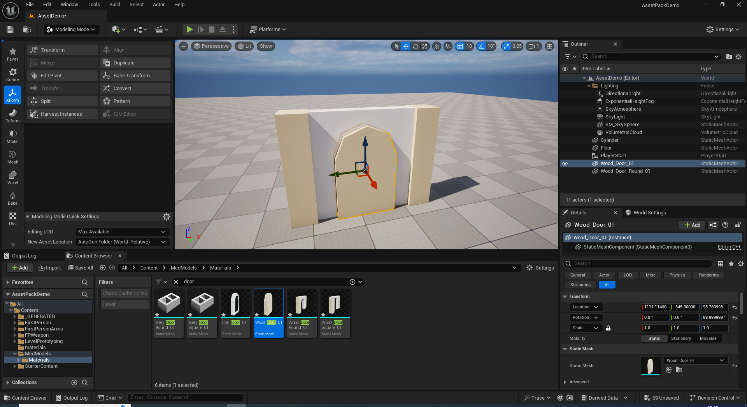
Changing a pivot

Slide 41
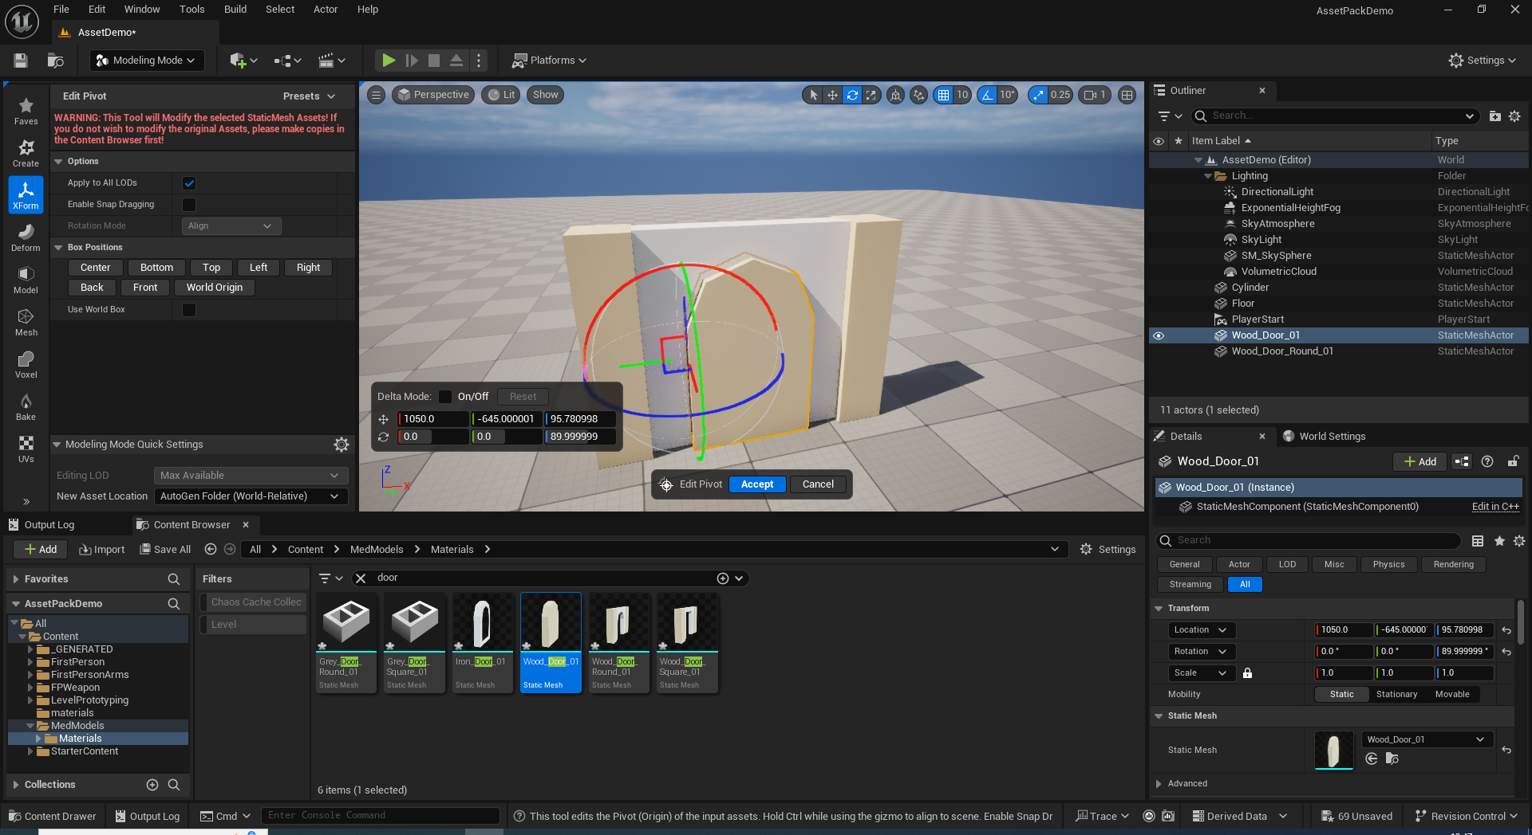
Handy quick snap options

Slide 42
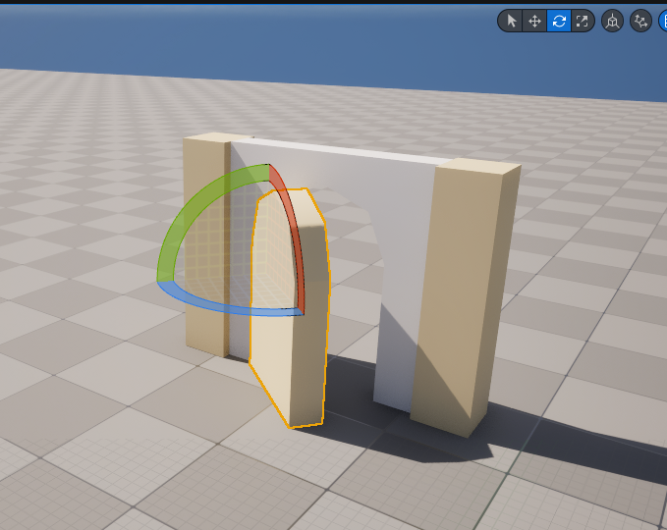
Success!

